Slide 1
Evaluation of style advisor performance
Comprehensive Analysis and Insights
Bonam Pooja
Coachx Batch - 112

Slide 2
Introduction
The project evaluates the performance of Style Advisors across different zones using a comprehensive set of criteria.
The analysis focuses on understanding performance trends, identifying high-performing regions, and areas needing improvement.
Objectives:
Grade Style Advisors based on their Evaluation_Score.
Analyze average evaluation scores by zone.
Identify regions with the highest percentage of high performers.
Visualize key trends and insights.
Provide actionable recommendations for management.

Slide 3
Data Columns:
Evaluation_ID: Unique identifier for each evaluation.
Evaluation_Date: Date of evaluation.
Evaluation_Score: Score given for the evaluation.
STORE AMBIANCE, FIRST IMPRESSIONS, DISCOVERY, etc.: Criteria used to assess performance.
Location_City, Location_State, Zone, Location_Country: Geographic details.
Time of entry, Time of exit, Duration of visit: Timing details.
Style Advisors Present, Customers Present: Number of advisors and customers during the visit.
Age of Auditor, Gender of Auditor, Auditor Attire: Demographics of the auditor.
Style Advisor Name, Style Advisor Description: Details about the advisor being evaluated.

Slide 4
Grading Scale:
High Performer: 90% - 100%
Average Performer: 70% - 89%
Low Performer: 50% - 69%
Bottom Performer: Below 50%
Example:
Evaluation_Score: 58 → Low Performer

Slide 5
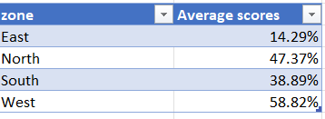
Average Evaluation Scores by Zone:
Key Observations:
North has the highest average score (76.74).
South has the lowest average score (66.61).

Slide 6
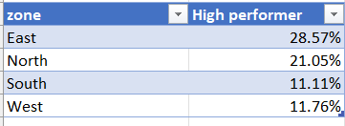
Percentage of High Performers by Region:
Key Insight:
East has the highest percentage of high performers (28.57%).

Slide 7
Bar Chart: Average Evaluation Scores by Zone
Pie Chart: Percentage of High Performers by Region

Slide 8
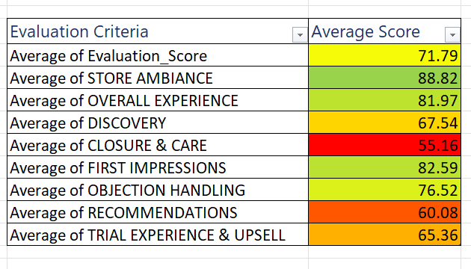
Line Graph: Performance Trends Over Time
Heatmap: Breakdown by Evaluation Criteria

Slide 9
Stacked Bar Chart: High vs. Low Performers Comparison

Slide 10
Key Insights
Consistent High or Low Scores:
North consistently performs well with the highest average score.
South needs attention due to the lowest average score.
High Performer Percentage:
East has the highest percentage of high performers (28.57%).
Trends Over Time:
Scores have remained relatively stable, with slight fluctuations.

Slide 11
Distribution of Performance Categories:
Majority of advisors fall into the Average Performer category.
Focus Areas for Improvement:
South Zone: Needs targeted training and support to improve scores.
Discovery & Closure & Care: These criteria have the lowest average scores across zones.
Best Practices from High Performers:
Share best practices from East and North zones with other regions.
Regular Monitoring:
Implement regular performance reviews and feedback sessions.

Slide 12
Summary of Findings:
North has the highest average score, while East has the highest percentage of high performers.
South requires immediate attention to improve performance.
Next Steps:
Implement recommendations to enhance overall performance.
Conduct follow-up evaluations to track progress.
Focus on improving South Zone performance.
Strengthen training for Store Ambiance and Discovery.
Monitor evaluation trends for consistency.

Slide 13

Thank you

